Slide 1

Ohio’s Alternate Assessment for Students with Significant Cognitive Disabilities
Online (2.0) Test Administration Training
Ohio Department of Education
American Institutes for Research
Notes:
Welcome to the Test Administration Training Module for Ohio’s Alternate Assessment for Students with Significant Cognitive Disabilities, or AASCD. This presentation covers important information you will need for administering the AASCD Online 2.0 test.
Only test administrators that have been trained on and administered the AASCD 1.0 should administer the AASCD online 2.0 test this year.

Slide 2
2.0 Online Training Objectives
Know what you must do to prepare for the Ohio AASCD Online administration, called the AASCD 2.0
Understand what is allowed and not allowed during administration.
Become familiar with the online testing systems.
Understand how to administer the Ohio AASCD Online Independent Field Test (IFT), called the AASCD 2.0
Notes:
This training will introduce the online AASCD, called the AASCD 2.0. This presentation will explain how to access the test administration systems such as the TA Interface and the Student Interface (also known as the Secure Browser). You will understand how to log into the TA Interface to create a test session ID, as well as how to select test accommodations and assist students to interact with the Secure Browser to participate in the new online AASCD tests.

Slide 3
When Is the AASCD 2.0 Administered?
April 15 – May 31, 2019
20 questions per grade per content area
Notes:
The Ohio AASCD 2.0 Online Independent Field Test (IFT) will be administered April 15 to May 31, 2019. These dates allow teachers and students to participate in the IFT after the operational test window concludes.
The IFT is not required, but it is highly suggested that districts participate to become familiar with and provide feedback for the AASCD online 2.0 administrations.
There will be no materials required to administer the AASCD 2.0 – all test items and responses appear in the student interface.

Slide 4
AASCD 2.0 Assignment by Grade
Student Grade | Content Areas to Be Administered to Each Student
3 | ELA and Mathematics
4 | ELA, Mathematics,
5 | ELA, Mathematics, and Science
6 | ELA, Mathematics,
7 | ELA and Mathematics
8 | ELA, Mathematics, and Science
10 - 12 | ELA, Mathematics, Science, and Social Studies
Notes:
AASCD 2.0 will be a grade level assessment. Each grade level and the corresponding content area assessments are listed on this slide.
The Test Administrator, or TA, should use the student’s enrolled grade to determine which grade and content areas should be administered.

Slide 5
AASCD 2.0 Key Dates
Activity | Date
Pre-ID Window Closes | May 31, 2019
AASCD 2.0 Test Window Opens | April 15, 2019
AASCD 2.0 Test Window Closes | May 31, 2019 @ 5pm
Notes:
The IFT should only be administered to students that have first taken the AASCD Operational 1.0 assessment. Students Pre-Identified in TIDE for AASCD 1.0 will already be eligible for the AASCD 2.0 assessment. Students participating in the 2.0 assessment should remain identified in TIDE through May 31st.
The AASCD 2.0 Test Window opens on April 15th, 2019.
The AASCD 2.0 Test Window closes on May 31st, 2019 @ 5pm.

Slide 6

New for 2018
AASCD 2.0 Online IFT
  Separate testing window occurring after AASCD 1.0
  Uses the Student Interface and the TA Interface
  Is grade level tested
  No SPQ to be completed
  Items are not scaffolded
  No Second Raters needed
AASCD 1.0 Paper Test
  For more information on what is new for AASCD 1.0, refer to the AASCD 1.0 Refresher here.
Notes:
AASCD 2.0 will be presented online in a separate window after the AASCD 1.0 administration. AASCD 2.0 will contain approximately 20 items in each grade and content area test. There are no SPQs to use to determine placement. The items will not have scaffolding and Second Raters will not be needed.
More on the AASCD 1.0 administration can be found in the separate AASCD 1.0 Refresher PowerPoint, available on the AASCD portal.

Slide 7
Test Security
Notes:
During this portion of the training, we are going to discuss test security for the AASCD.

Slide 8
Test Security
Security is vital for future administrations, as well as the current administration.
You are responsible for ensuring the security of all online test content.
Your responsibility for the security of the online test content does not end after the test is completed.
Notes:
Each test contains questions that will be used on future forms of the test. Therefore, security is vital for future administrations, as well as the current administration.
You are responsible for ensuring the security of all online test content.
Your responsibility for maintaining the security of test questions and materials does not end after the online test is completed. You cannot tell other teachers or parents what the test contains.
When giving examples of test items, please use only the items that appear in the online Practice Tests available on the portal. Do not use examples of actual test items.

Slide 9
Test Security Law
Under Ohio law (OAC 3301-7-01, 3301-13-02, 3301-13-05; ORC 3319.151, 3301.0710), releasing any test question or other content of a test to students or assisting students to cheat in any way may result in invalidation of test scores, termination of employment, suspension of license to teach, and/or prosecution.
A test incident must be reported to the Ohio Department of Education as soon as it becomes known to the district. Investigations involving breaches in security (violating the Ohio Administrative Code) must be documented and submitted to the Ohio Department of Education within 10 days following the conclusion of the investigation.
A summary of state security provisions is included in
Rule 3301-13-05 of the Administrative Code.
Notes:
Be aware that, under Ohio law, releasing any test question or other content of a test to students or helping students to cheat in any way may result in invalidation of test scores, termination of employment, suspension of license to teach, and/or prosecution.
A test incident must be reported to the Ohio Department of Education as soon as it becomes known to the district. Investigations involving breaches in security (violating the Ohio Administrative Code) must be documented and submitted to the Ohio Department of Education within 10 days following the conclusion of the investigation.
If you have questions or concerns about your responsibility for test security, consult your Board-adopted policy.

Slide 10
Online Test Security Training
New Test Security training is available for DTCs, TCs, and schools
  Located on the portal and ODE website.
  https://oh-alt.portal.airast.org/core/fileparse.php/3153/urlt/Test-Security-Training-Resource-for-Districts.pdf
Notes:
The New Test Security training is available for DTCs, TCs, and schools. It is located on the portal and ODE website.

Slide 11
Ethical Use of Tests
Is this activity or behavior an ethical practice? | Yes | No
Making a copy of the alternate assessments and/or preparing a student study guide based on the alternate assessments. |  | X
Changing a student’s response. |  | X
Using a student’s login information to access an online test in order to review test content. |  | X
Hinting to a student to reconsider any answers given on a test. |  | X
Revealing the test scores of one student to another student. |  | X
Providing teachers and counselors with information they need to interpret test results. | X
Preparing students for the alternate assessments by incorporating the extended standards in the appropriate subject curriculum. | X
Notes:
This slide shows different scenarios reflecting ethical practices in test administration.
Examples of activities that are not ethical include:
Making a copy of the alternate assessments,
Changing a student’s response,
Using a student’s login information to access an online test in order to review test content,
Hinting to a student to reconsider answers, and;
Revealing a student’s test score to another student are all examples of activities that are not ethical.
Next, we will discuss test accessibility.

Slide 12
Test Accessibility for AASCD 2.0
Notes:
During this portion of the training, we are going to discuss the test design accessibility (accommodations) on the AASCD 2.0.
These are the accommodations used during daily instruction and may be listed on the student’s IEP.

Slide 13
Accessibility
Picture Communication Symbols™ (PCS™) have been used throughout the tasks and items.
If your student uses a different symbol for the same word, you may substitute that symbol for the one provided. For example:
™
™
Notes:
Throughout the assessment, response cards are used that contain the picture symbols created by Mayer-Johnson. Many teachers use these during instruction, when creating communication books, and when using Boardmaker™ or PCS™.
The Mayer-Johnson artists are wonderful, but occasionally there is more than one symbol for the same word. Therefore, if the assessment has a picture that is different from the one used in instruction, you may use the picture your student knows.

Slide 14
Accessibility (cont.)
Response Options:
TTS must first read all questions, options, and stimuli.
The teacher may point to or indicate each response option as it’s being read aloud by TTS.
The teacher may re-state or re-read all text after TTS has completed reading.
Notes:
Here are several ways the TA can make the Response Options accessible for students:
For each item, after the Text-to-Speech reads the item, you will say each response option aloud, but you cannot use any type of voice inflection to lead the student to the correct response. You can indicate each response option, but you cannot lead the student to the correct response by tapping, pointing to the correct response for a longer period of time, or in any other way indicating the correct answer. The answer options must be indicated in the order they appear on the screen.
Sometimes a student will point to one answer but say another. As Test Administrator, you must determine prior to administering the assessment which answer option you will accept: what the student says or what he or she points to.
A student may also repeatedly indicate that the last thing the Test Administrator says is the correct answer. The correct answers are randomized and are not always in the same location, so sometimes the last option will be correct. You should accept the answer and move on to the next item.

Slide 15
Accessibility (cont.)
Customizing:
Provide calculators and scrap paper unless otherwise noted.
Allow student to use the AAC that is used during daily communication.
Refocus and repeat as needed.
Notes:
The TA may customize materials on the AASCD:
On the mathematics assessment, calculators and scrap paper are allowed unless otherwise noted.
You should allow the student to use his or her communication device when taking the assessment. This should be the same device that the student uses during daily instruction and communication, as specified in the student's IEP.
Refocusing the student’s attention on the task is allowed, even though there are no specific provisions for it in the script.

Slide 16
Accessibility (cont.)
Reading:
After TTS reads passage, the TA may read passage aloud.
After TTS reads passage, the TA may read answer options aloud.
Reread passage (do not lead student to correct answer).
Take breaks as needed (Test Administrator or student).
  Do not re-administer any items when you return.
Notes:
The AASCD has accessibility features built-in to the assessment:
TAs can always read the passage and answer options aloud, after Text-to-Speech has read it. The passage can be re-read as often as needed. For the reading assessment, you will frequently be directed to re-read a specific page or paragraph. But when reading aloud, you cannot lead the student to the correct answer in any way.
This assessment is not timed; therefore, you should take a break or stop the administration if the student becomes fatigued or ill, or if other circumstances require you to stop. The breaks can be very short or even continue into the next day. When you restart the assessment, you may re-read the passage or reorient the student to the task. However, you should not go back and re-administer any items for which a student has already given a response.

Slide 17
English Learners
Like the general assessment, translation into foreign languages is not allowed for the ELA alternate assessment.
Interpreters and translators who do not meet the requirements to be a Test Administrator must sign a non-disclosure agreement if they will have access to secure testing materials.
Notes:
Like the general assessment, translation into foreign languages is not allowed for the ELA alternate assessment. The alternate mathematics and science tests may be translated. A student who receives instruction in his or her native language may have a translator for the AASCD. Translators may serve as the Test Administrator if they meet the following qualifications: (1) trained to administer the AASCD; (2) hold a certificate, license or permit issued by the Department; and (3) employed by the school district.
Interpreters and translators who do not meet the requirements to be a Test Administrator must sign a non-disclosure agreement if they will have access to secure testing materials. Please consult your District Test Coordinator if you require a non-disclosure form.
It is not expected that foreign language translation will translate verbatim from English to the native language; however, it is expected that it should faithfully translate, to the greatest extent possible, all of the words on the test without changing or enhancing the meaning of the content, adding information or explaining concepts unknown to the student. If a word in English cannot be translated, the English word must be used and no definition or description may be provided.

Slide 18
AASCD 2.0 Online Systems
System | Description
Test Information Distribution Engine (TIDE) for online administrations | Student identification (name, SSID, grade, etc.) User management (for TCs) Monitoring Test Progress access available to all user roles track the status of data entry and test submission
Test Administrator Interface | Creation of the test session Confirming the student’s test settings Approving the student to begin testing
Student Interface Aka; Secure Browser | Secure environment Student sign-in
TA Practice Site Student Practice Site | Allows TAs and students to become familiar with the online testing environment Allows the TA/teacher to confirm which accessibility feature(s) best suit the student, prior to testing day.
Notes:
There are three online systems that support the AASCD 2.0 administration. All three systems can be accessed from the portal. Each system has different levels of access for each user role. In short:
TIDE is used by District Test Coordinators (DTCs) to pre-identify students before the students can access the AASCD Online Practice Test and Independent Field Test. DTCs also use TIDE to create and manage user accounts for other district and school personnel.
The TA Interface is used by the Test Administrator or Teacher to start a test session, review a student’s test settings and approving the student to begin testing.
The Student Interface is accessed through the Secure Browser. This is a secure environment that the students must log into to access the AASCD online tests.
The TA Practice Site and Student Practice Sites are available on the AASCD portal. These sites should be used by administrators and students to become familiar with the online testing environment and available accessibility features, prior to the Independent Field Test.

Slide 19
User Accounts
Test coordinators (DTCs, DAs, or BTCs) are responsible for creating all TE and TA user accounts.
  All TE and TA accounts from Spring 2018 were maintained. Users are required to set a new password for Spring 2019.
For a student to be able to access your online test session, your account must be associated in TIDE with the same school as the student.
Users can only view student information for students in their associated schools.
Users can have different roles in different schools and districts. For example, a person can be a TE in School A and a TA in School B.
  The same email address should be used to add users to multiple schools or districts.
Contact your TC to request an account before the test window.
Notes:
In the next two slides we’ll review some important information about your user account. All personnel administering the AASCD 2.0 must have an account to access the AASCD online systems. Accounts are created by test coordinators in TIDE. There are three types of accounts: Teachers (or TEs), Test Administrators (or TAs), and Second Raters (or SRs). The TA role is recommended for personnel serving students out of district, and the SR role is for personnel who are only serving as Second Raters in a particular school for the AASCD 1.0 tests. Second Raters are not needed for AASCD 2.0 tests.
All user accounts have been maintained from the previous administration. All users received a request to update their passwords in August. Test coordinators are responsible for maintaining user accounts for district and school personnel.
For a student to be able to access your online test session, your administrator account must be associated in TIDE with the same school as the student.
Users can only view student information for students in their associated schools.
Users can have different roles in different schools and districts. For example, a person can be a TE in School A and a SR in School B.
The same email address should be used to add users to multiple schools or districts. Contact your TC to request an account in advance of the test window.
NOTE: Personnel administering assessments to students served outside the district should contact the DTC in advance of testing to request a TA account.

Slide 20
User Accounts (cont.)
When a TC creates a user account, the new user will receive an activation email containing a temporary password.
Your email address will serve as your username.
You MUST log in using the temporary password and establish a new password within 15 minutes of receiving the email. If the link expires, you can request a new link be sent.
If you fail to do so, you can request a new activation email on the login screen. See the TIDE FAQ on the portal.
The email will come from AIRAST-DoNotReply@airast.org
Do not share your password with anyone!
Notes:
When a new user account is created, users will receive an activation email containing a temporary password. You MUST log in using the temporary password and establish a new password within 15 minutes of receiving the email. If the link expires, you can request a new link.
Do not share your username or password with anyone!
TIDE, the DEI, and the ORS all contain secure student and test information. It is very important that security is maintained.
Additional information regarding user roles can be found on the Portal.

Slide 21
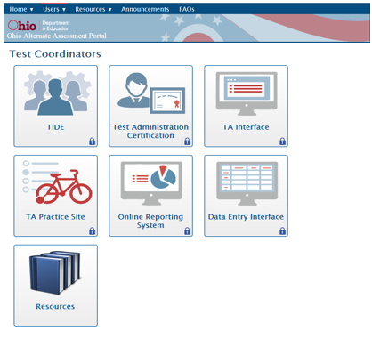


TA and Student Interfaces
Secure Browser icons
Notes:
Two devices are required to administer these tests. On the first device, the TA uses the Test Administrator Interface to start and monitor a test session. The Student Interface is the system students use to take the AASCD 2.0 - Online Assessment. The TA will assist the student in taking the test on the second device using the Secure Browser. The Secure Browser is designed to ensure test security by prohibiting students from accessing any other programs or websites during testing.
If the Secure Browser detects a forbidden application, a message will display that identifies the offending application and the student will be prevented from continuing testing until the application is closed. This message also displays if a forbidden application launches in the background while the student is already testing in the Secure Browser. In most cases, a forbidden application is a scheduled or background job, such as antivirus scans or software updates. The best way to prevent forbidden applications from running during testing is to schedule such jobs outside of planned testing hours.
The Secure Browser can be accessed through the Portal, which we will discuss in detail a bit later in this training.

Slide 22
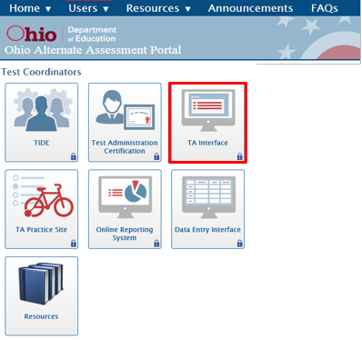
Test Administrator Interface
Notes:
The Test Administrator Interface is accessed through the portal. From the portal landing page select either the Teachers/Test Administrators card or the Test coordinators card. On this page select the TA Interface card.

Slide 23
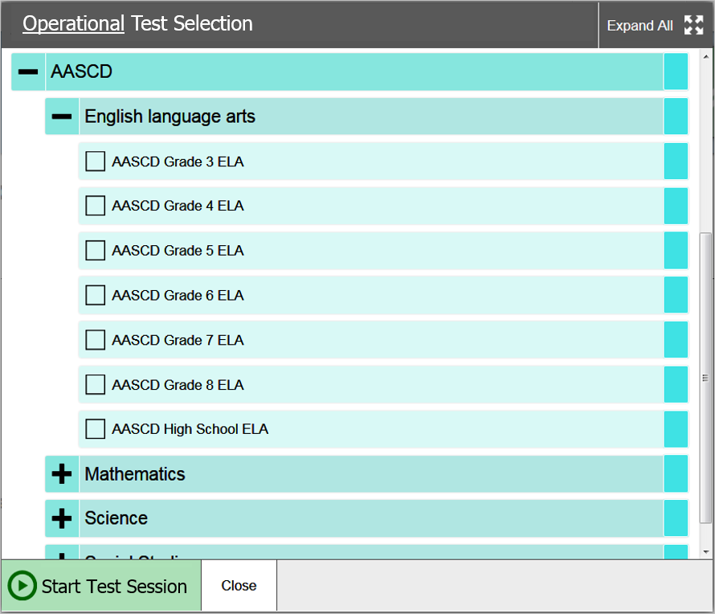
Test Administrator Interface
Notes:
The first step in the Test Administrator Interface is to select the test or tests that you plan to administer.
When you first log in, you will see a pop up with all of the possible tests you can select. The AASCD tests are listed in teal at the bottom of this pop-up screen. You can expand the list of tests by selecting the “plus” sign. You can collapse a list by selecting the “minus” sign.
If you are not sure which test your student needs to take, you may choose all tests listed in a category. For example, if your student needs to take the Grade 5 Mathematics test, click the box next to Grade 5 Mathematics to add it to the test session. Individual students can only take tests for which they are eligible.

Slide 24
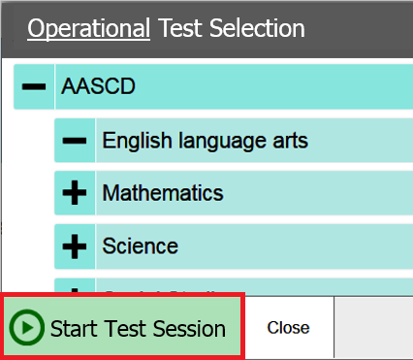
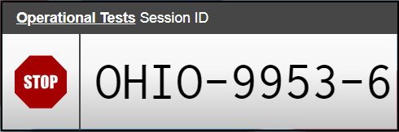
Starting a Test Session
Notes:
After you are done selecting the tests for your session and are ready to begin testing the student, click on the Start Test Session button. A test session ID will generate and display on the top right of the TA Interface. You may want to keep a record of the Session ID for your own reference as well, as this information may be useful if you encounter a problem and need to contact the Ohio Alternate Assessment Help Desk.
Please note that TAs should not start the test session until the student is prepared to test. For security purposes, the TA session will close after 20 minutes of inactivity on the TAs device.

Slide 25
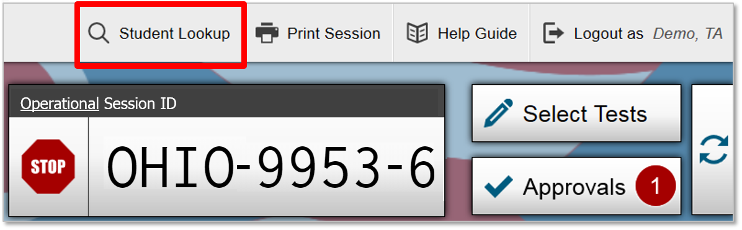
Student Lookup Tool
Notes:
The student’s first name, the student’s SSID, and Session ID are all required for a student to enter a test session.
If you don’t have login information for a student or one of your students is having difficulty logging in, you can use the Student Lookup function to find that information. Select the “Student Lookup” button located at the top of the screen. Please note: the Student Lookup function will only give you a student’s name and SSID number. It cannot tell you which test(s) the student is eligible to take.

Slide 26
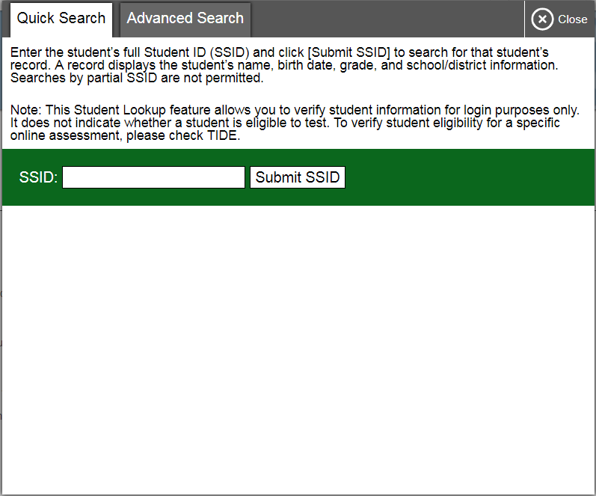
Student Lookup Tool (cont.)
Notes:
Next, you can select either the “Quick Search” tab or the “Advanced Search” tab. The “Quick Search” tab lets you look up a student’s first name as it appears in TIDE if you know the student’s SSID number. Enter the student’s SSID number in the box and click the “Submit SSID” button.

Slide 27
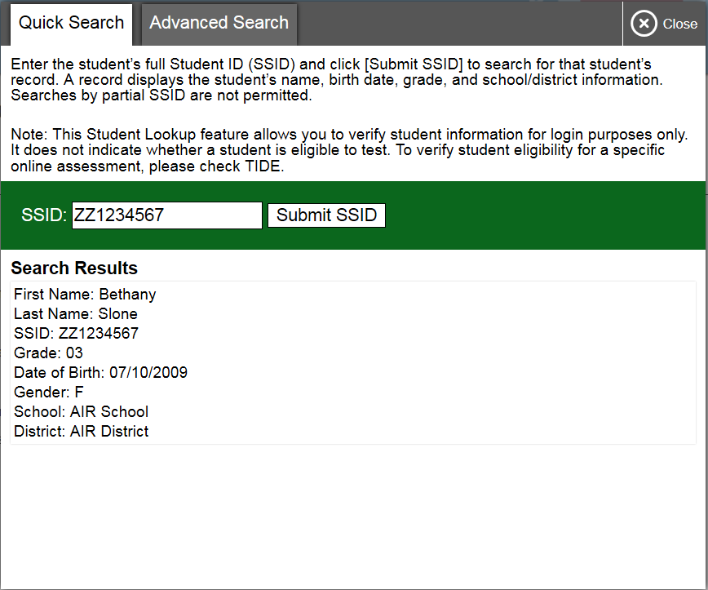
Student Lookup Tool (cont.)
Notes:
The Quick Search results include the student’s full name, enrolled grade, birth date, school, and district.

Slide 28
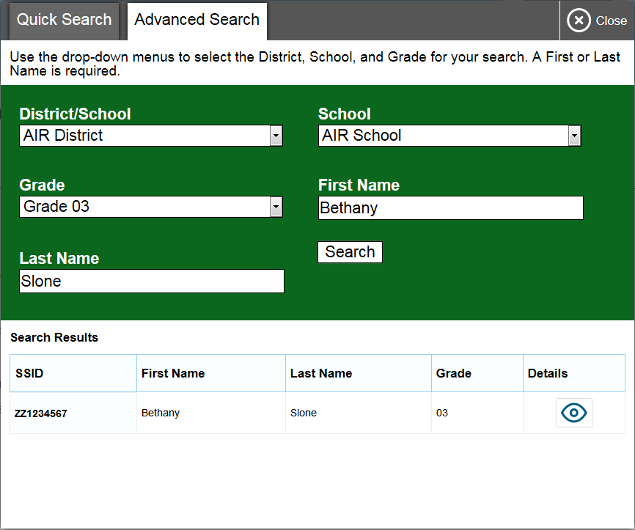
Student Lookup Tool (cont.)
Notes:
If you need to look up a student’s SSID number, you can do it by selecting the “Advanced Search” tab. First, select the student’s district, school, and enrolled grade using the drop-down menus. Then enter the student’s first and last name and select “Search.”
Once you have all the necessary information, you may log in for your student or help them log in for themselves.
Be sure that the Secure Browser is open and ready for testing on the device that student will use.

Slide 29
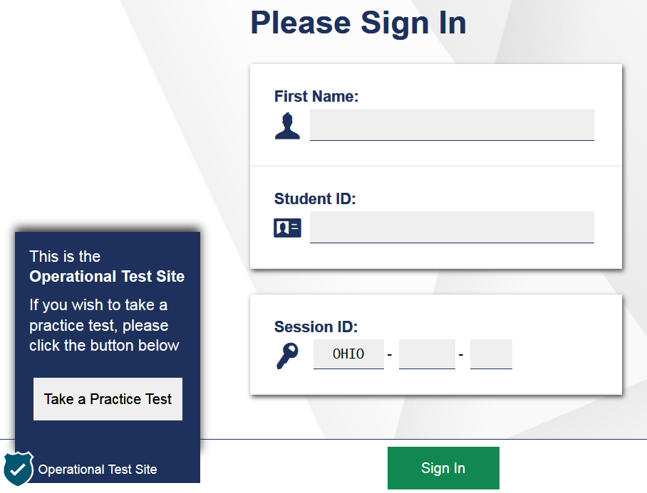
Test Sign In
Notes:
Remember, the TA and the student will each need separate devices during the online test administration.
To log in to the Secure Browser, three pieces of identifying information must be entered into the student sign in page: the student’s first name, the student’s state student identification number (SSID), and the current session ID. The student’s SSID can be retrieved in TIDE and in the TA interface.
When the three fields are filled, click the Sign In button to log in to the student interface. You may assist students with logging in as necessary.
If you or your student is having difficulty logging in, an error message and code will display on the login screen. The most common errors occur when the student’s first name and SSID do not match what is in the system or when SSIDs are entered incorrectly. If the student receives an error message indicating that he or she entered incorrect information in the first name or SSID fields, the TA should use the Student Lookup Tool in the TA Interface to verify the student’s information.
Another common error occurs when the student enters an incorrect session ID. If a student receives the message “The session is not available for testing,” verify that the session ID was entered correctly, with no extra spaces or characters. The session ID can be found in the TA Interface. If a student receives the error message “Session has expired,” ensure that the correct session ID for the current session was entered. If the session ID was entered correctly, use the TA Interface to verify that your session is still open.
Finally, if administering a practice test, make sure that the TA and the student each use the appropriate practice and training test site. If administering an operational test, ensure that the TA is using the Test Administration site and the student is using the Secure Browser. If taking a practice test, you may log the student in as a guest, without entering their name or SSID.
If you are still experiencing difficulty logging in, please contact the Ohio Alternate Assessment Help Desk.

Slide 30
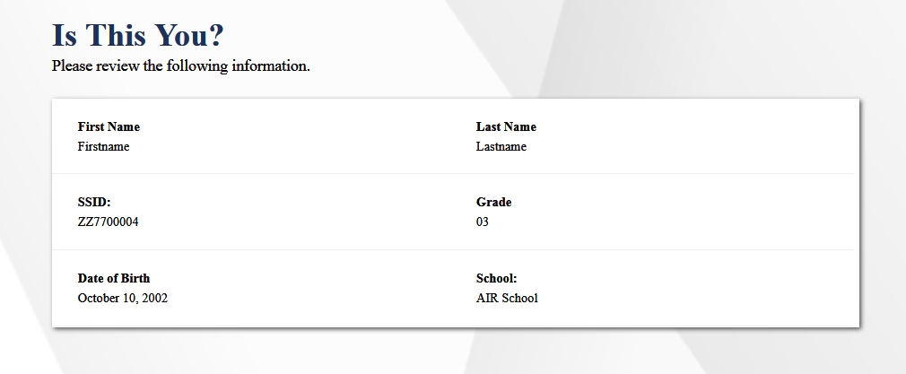
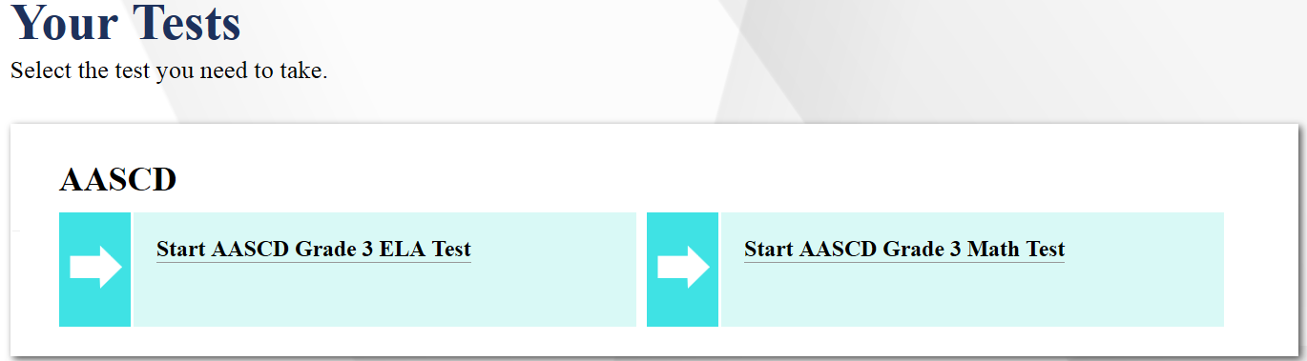
Confirming Sign-In
Notes:
After logging in, TAs need to help students complete a few more steps before they begin testing. Again, TAs may perform these steps for the student to log them in beforehand.
Assist your student in verifying their personal information. If the information is correct, you or your student can click Yes to proceed. If the information is incorrect, click No to return to the login page. You must then contact your DTC to have the student’s information updated in TIDE before the student attempts to log in again.
On the “Your Tests” screen, you will see a list of the student’s assigned tests for this test session. Students will only see tests that they are eligible to take according to their tested grade, and only if the TA has added those tests to the test session. If a test has already been completed, the test selection button will be grayed out. Once you have selected a test, you will see a message that says “Waiting for TA approval…”
After selecting the student’s test, you will need to return to the TA Interface on your own device to approve the student’s entry into the test session.

Slide 31
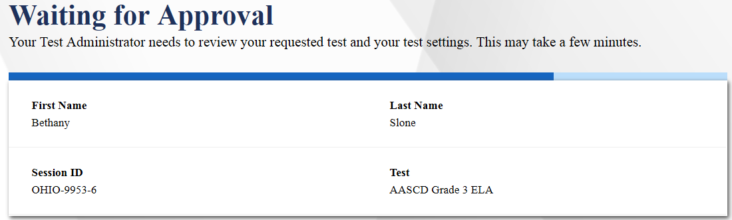
Student Interface
Notes:
The student will see a screen telling him or her to wait for test administrator approval. You must approve all tests in the Test Administrator Interface on a separate computer before the student can begin.

Slide 32
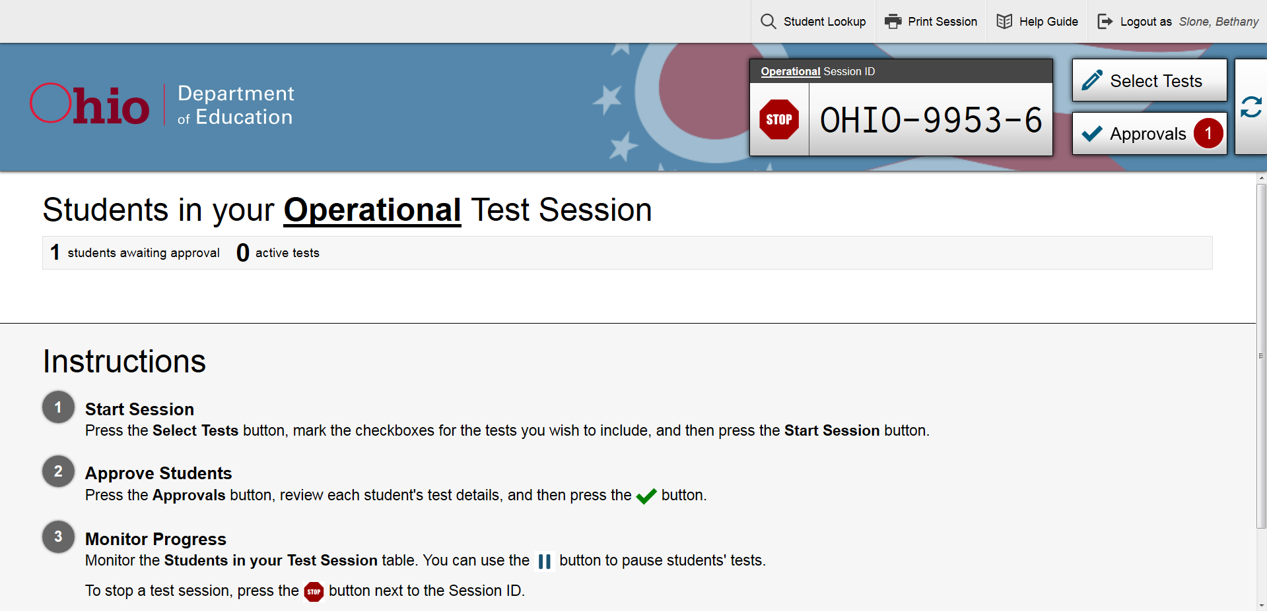
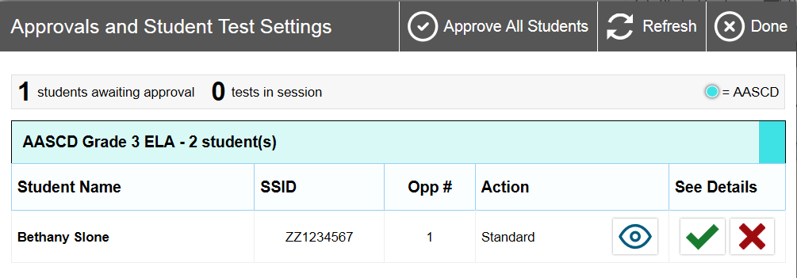
Approving Tests
Notes:
We will now return to the Test Administrator Interface. On the right side of the screen, you will see the student approval box that shows you which students are waiting for your approval. In this example, one student is waiting for approval. Select the “Approvals” button to see the student who is waiting to begin their test.
Please note that the TA Screen automatically refreshes every 30 seconds. If no approvals are waiting, you may either wait for it to refresh or you may immediately refresh the TA screen by selecting the “refresh” button with the two arrows in the shape of a circle. Once the Approvals button is active, click on it to see the student waiting for test approval.

Slide 33
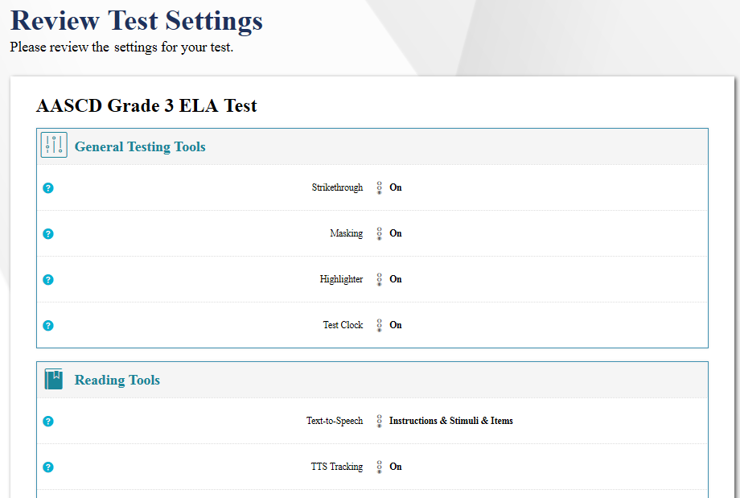
Test Settings
Notes:
After the TA has approved the student, the student will see a screen that displays the name of the test and selected test settings. If the information is correct, you or the student should select Yes. If any of the information is incorrect, select No and then change the necessary test settings. As a reminder, you may select certain test settings in TIDE or in the TA interface before approving the student to test. Note that the actual settings students see may vary from what is shown on this slide.

Slide 34
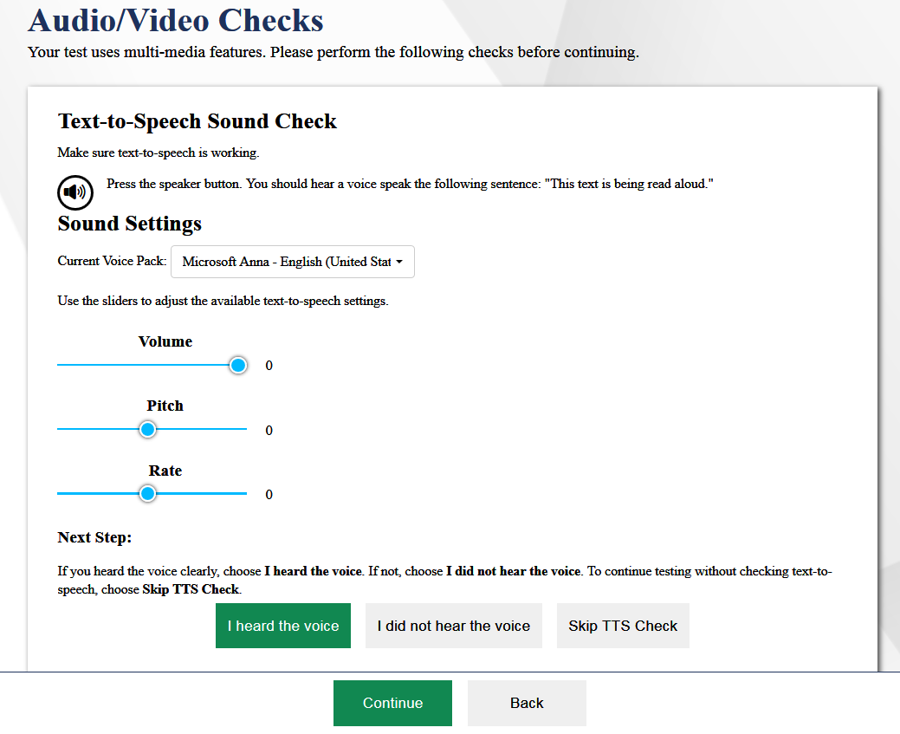
Sound Check
Notes:
This step is critical to ensure students complete the online tests successfully. The AASCD 2.0 requires TTS to be turned on; there are no options to turn it off. Students must hear TTS read all text and options presented on the screen.
After verifying their test, students will proceed through one or more functionality checks to make sure their testing device is functioning properly. The functionality checks that appear will depend on the test that the student is taking.
Students will be presented with a TTS Sound Check screen that verifies that text is being spoken correctly on their device. Press the speaker button to hear sample text being read aloud.
It is important to use this screen to adjust the volume, pitch, and rate of how TTS will read the text for the student. Should the student begin the test and need the volume, pitch, or rate adjusted that can be accomplished within the test environment, as well. This will be covered in the next slides.
If the voice is audible, select I heard the voice to proceed. If not, you may adjust TTS settings using the sliders at the bottom of the page and try again. If you still cannot hear the voice, log out of the secure browser and adjust the audio settings on the device used for testing as well as the browser.
After you select I heard the voice, you or the student will need to select the Continue button. If you do not hear the voice, log out of the secure browser and adjust the audio settings on the device used for testing.

Slide 35
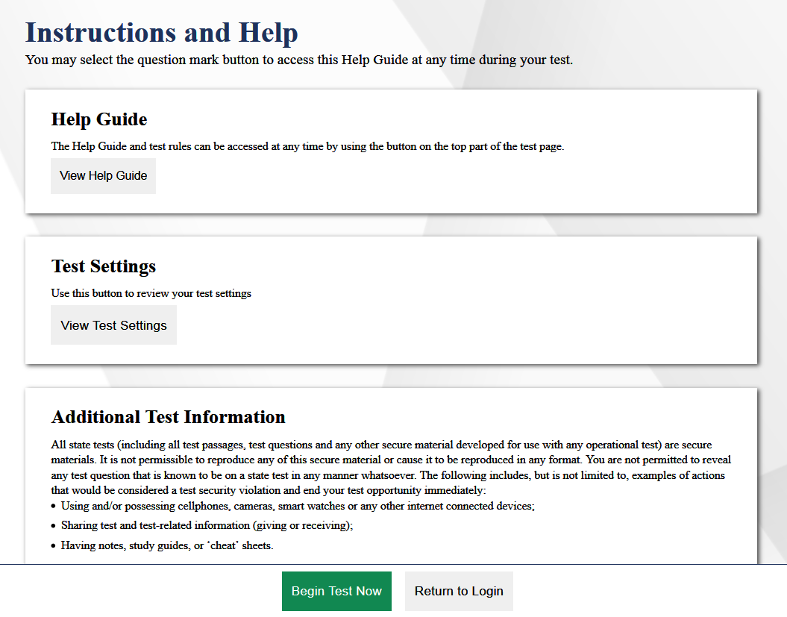
Help Guide
Notes:
The last screen students will view before beginning a test is the Instructions and Help page.
If you need to adjust any test settings, select View Test Settings.
If you do not need to adjust the test settings, read the Additional Test Information and then you or the student will need to select Begin Test Now.

Slide 36

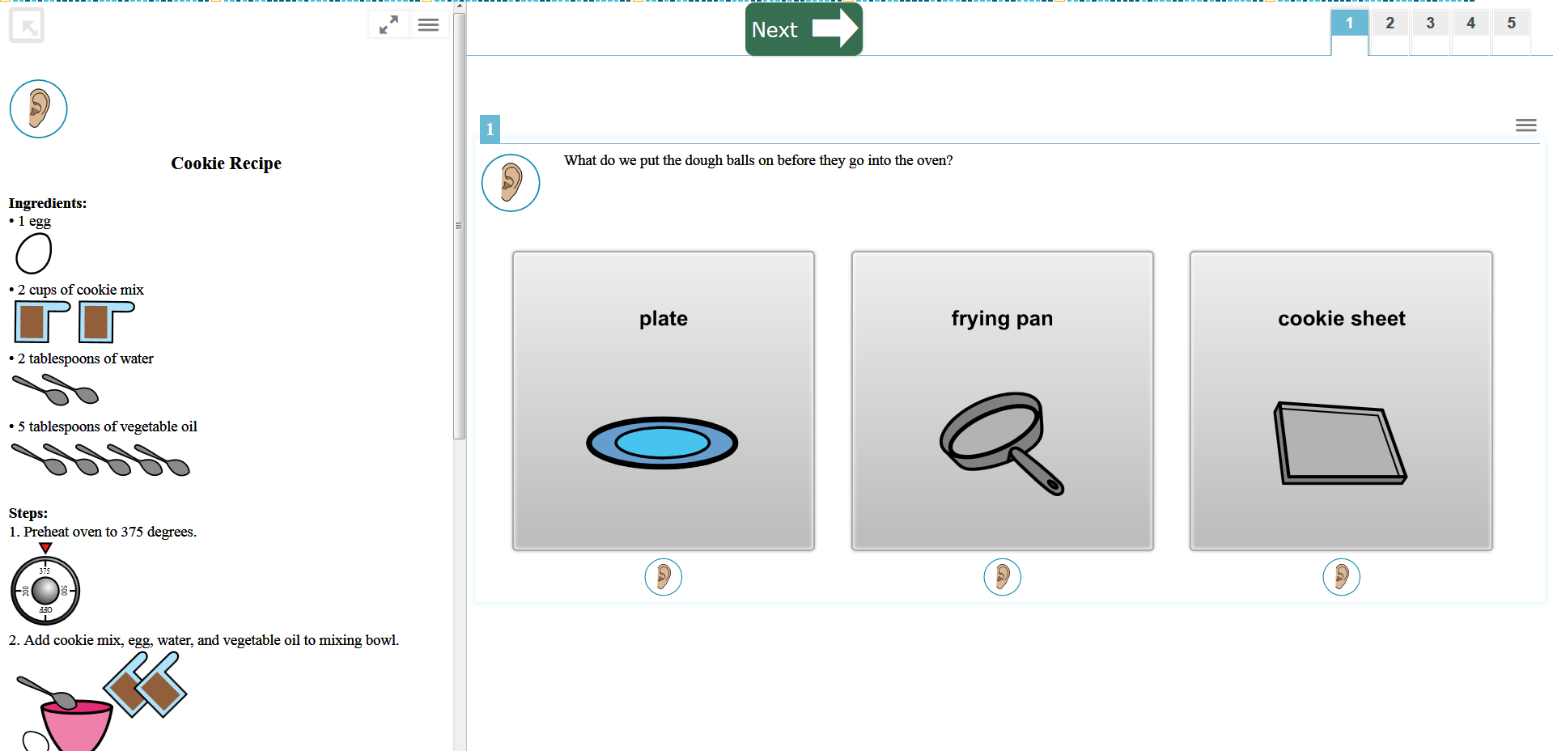
The Student Interface
Notes:
During the test, students will select a response for each question. You may offer assistance if the student cannot physically make a selection on the device screen. After selecting a response card, select Next to proceed to the next test item.
You will see an ear icon next to each test passage, question, and response option. Select the ear icon next to it to have the computer read aloud using Text-to-Speech, or TTS.
For each test item, you can support your student by selecting the ear icon to play audio for the stimulus or passage (if there is one) and for the question.
When you select the ear icon next to a question, both the question and the response options will be read aloud. You can replay the audio by selecting the ear icon below each individual answer option as needed. The TA is also permitted to read aloud any text or option choices after TTS completes the reading. It is imperative that the TA allow the TTS audio to read any text and option choices aloud prior to the TA repeating the text and option choices for the student. This is important because, in the sample image shown here, the TTS audio for the first response could read “on a plate” and not just “plate”.
Should the student require the volume, pitch, or rate of TTS to be adjusted that can be accomplished within the test environment, as well.

Slide 37
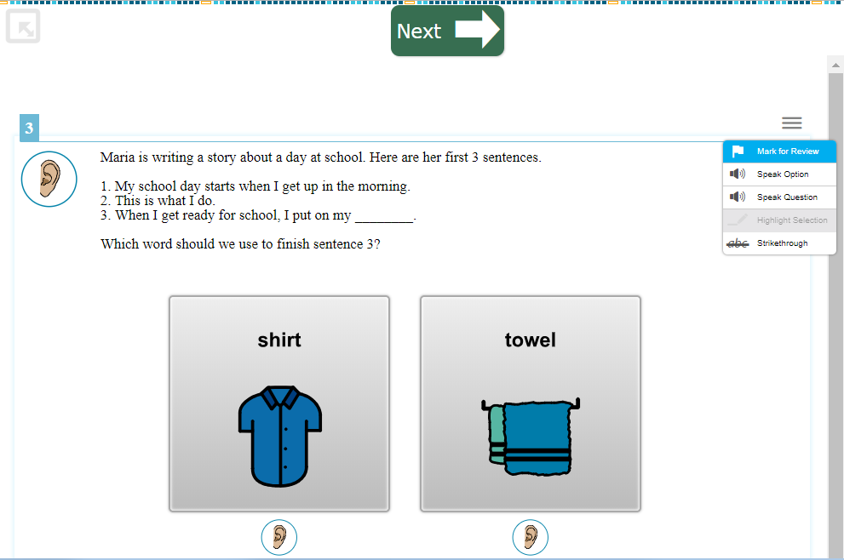
Context Menu
Notes:
Should a student need to access the mark for review tool it can be found in the item context menu. The context menu appears as three short lines in the top right corner of the item.

Slide 38
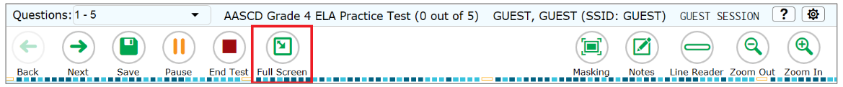
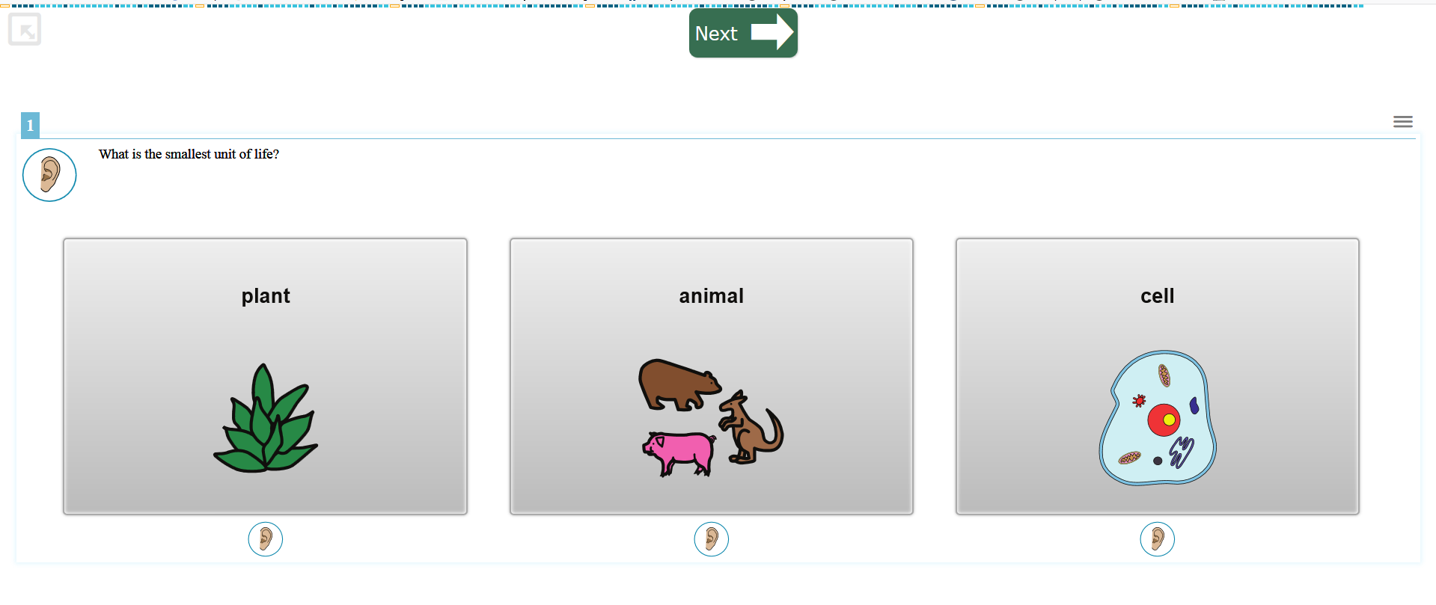
Global Toolbar
Notes:
By default, the global toolbar is hidden from view for AASCD tests. To access the toolbar, click the gray button in the top left of the page. You will be prompted to enter a password. The password is the student’s first name.
Once the toolbar has been accessed, it will remain visible throughout the test session until the [Full Screen] or [End Test] icon is selected.
The global toolbar allows the TA (or student) to move back to a previous item using the back button or to move forward in the test using the next button. Also, the [Save] feature can be accessed here, as well as [Pause] and [End Test]. Additional tools such as masking, notes, line reader, and zoom in or out are accessible through the global toolbar menu.
If at any time during online test administration TTS needs to be adjusted, the TA can open the global toolbar (following the steps described above) and select the small gear icon in the top right corner. This small gear icon will open the TTS settings, and the TA can adjust the volume, pitch, and rate of TTS. The TA will not need to pause the test and log the student out of the secure browser to adjust the TTS settings.

Slide 39

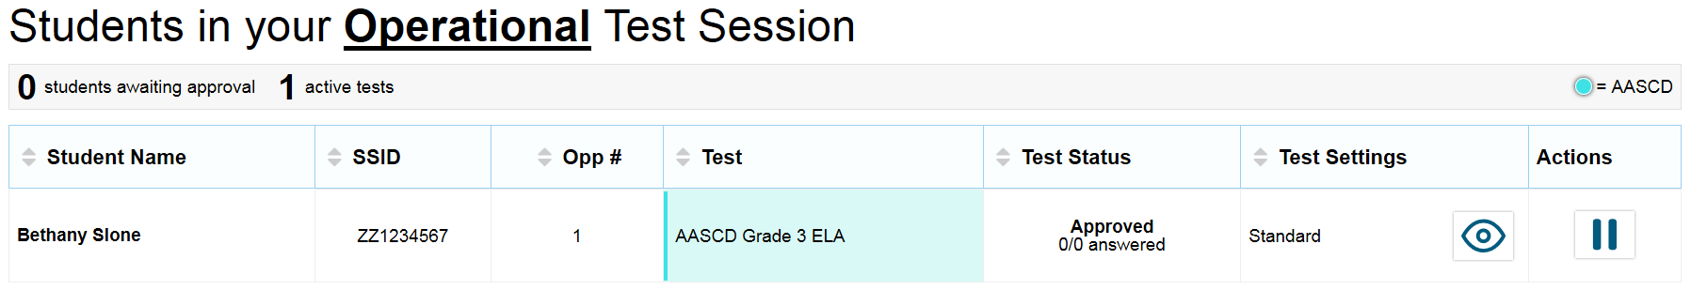
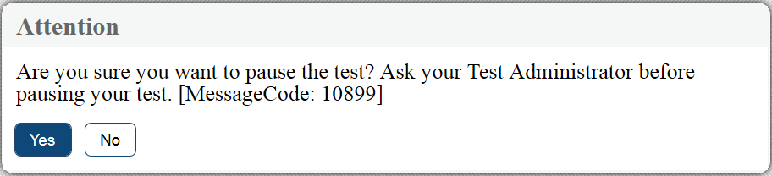
Pausing the Test
Notes:
If the student’s test needs to be paused, select the “Pause” button from the global menu. A pop-up message will appear on the screen asking for confirmation that the Pause button has been selected. The TA can also pause the student’s test from the TA Interface.
For AASCD tests, if a student’s test is paused, the test can be resumed on a subsequent day within the test window, by logging the student back in and selecting the test to resume.

Slide 40

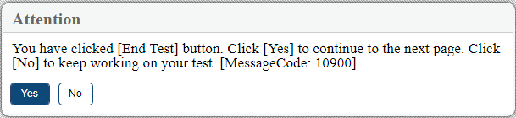
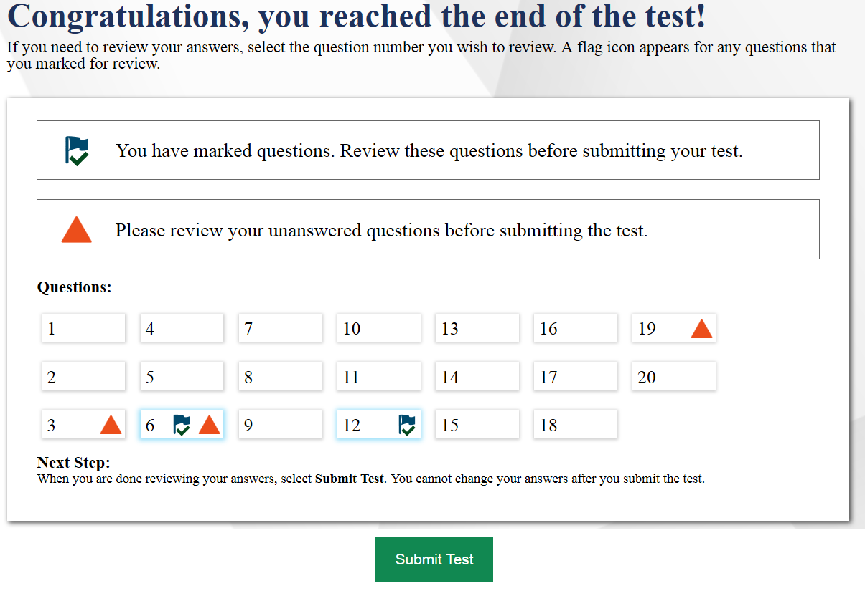
Ending the Test
Notes:
Once the student has completed testing, the student or TA should select the “End Test” button from the global menu. A pop-up message will appear on the screen asking for confirmation that the End Test button has been selected. Select No to return to the test or Yes to proceed to the End Test page.
From the End test Page, students can click on the item number to review answers or submit the test for scoring. A flag icon appears for any questions marked for review. A warning icon appears for any unanswered questions. If the test is ready to be submitted, click the Submit Test button. The test will no longer be available once the test has been submitted.

Slide 41
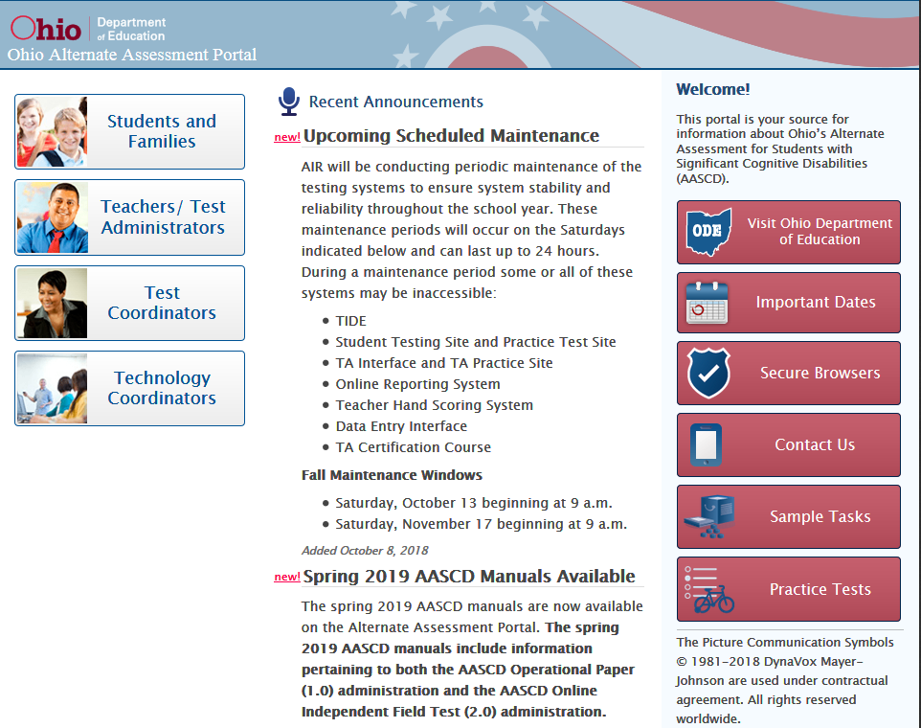
Alternate Assessment Portal
For more information:
Visit the Ohio Alternate Assessment Portal at http://oh-alt.portal.airast.org/.
    Note: No username or password is required to access the portal itself.
Access online systems
Find resources
FAQs
Notes:
You may also visit the Ohio Alternate Assessment Portal to access online systems, such as the online AASCD Practice tests, find resources, and read FAQs.

Slide 42
Contact Information
For questions about online AASCD practice tests and the IFT administration:
Ohio Help Desk
1-877-231-7809
Ohhelpdesk@air.org
Notes:
For questions about the online AASCD practice tests and the IFT administration, please contact the Ohio Help Desk by phone or by email.

Slide 43
Additional Training
State Support Teams
Education.ohio.gov
Key Word Search: State Support Team
Notes:
If you feel you would like additional face to face training or need additional support in how to administer the online assessment, you can contact your regional state support team. Each state support team has at least one staff member who is a specialist in the alternate assessment. To find which region serves you, go to the Ohio Department of Education website and search keyword State Support Teams.

Slide 44
Contact Information (cont.)
Andrew Hinkle
Office for Exceptional Children
andrew.hinkle@education.ohio.gov
(614) 466-2650
Cathie Rollings
Office of Assessment
Cathie.rollings@education.ohio.gov
(614) 387-7715
Notes:
Finally, you may reach out to the Ohio Department of Education using the contact information shown here.
Thank you for viewing this training module. We wish you success in administering the AASCD.

