Slide 1
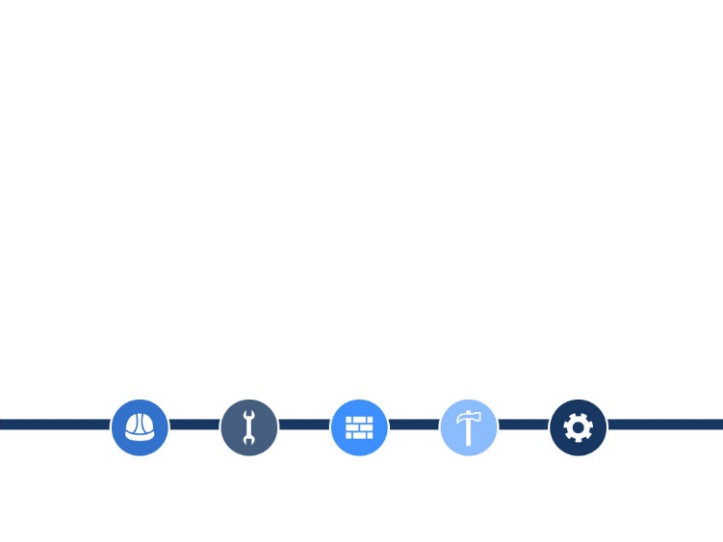
Spring Community Forum Tuesday, May 2, 2017 Sandusky High School Room 300 6:00 pm
BUILDING BETTER DREAMS

Slide 2
Dr. Eugene T. W. Sanders
Chief Executive Officer & Superintendent

Slide 3
Introduction of Program Participants
Update on Transformation Plan
Dennis Kaplan, OFCC Representative
John Feick, District Owner’s Representative
Lesko Architecture
Gilbane-Ozanne Construction Management
Facilities Budget Update
Building Assignments with Academic Priorities

Slide 4
Mr. Dan Poggiali
Chief of Staff & Transformation Officer

Slide 5
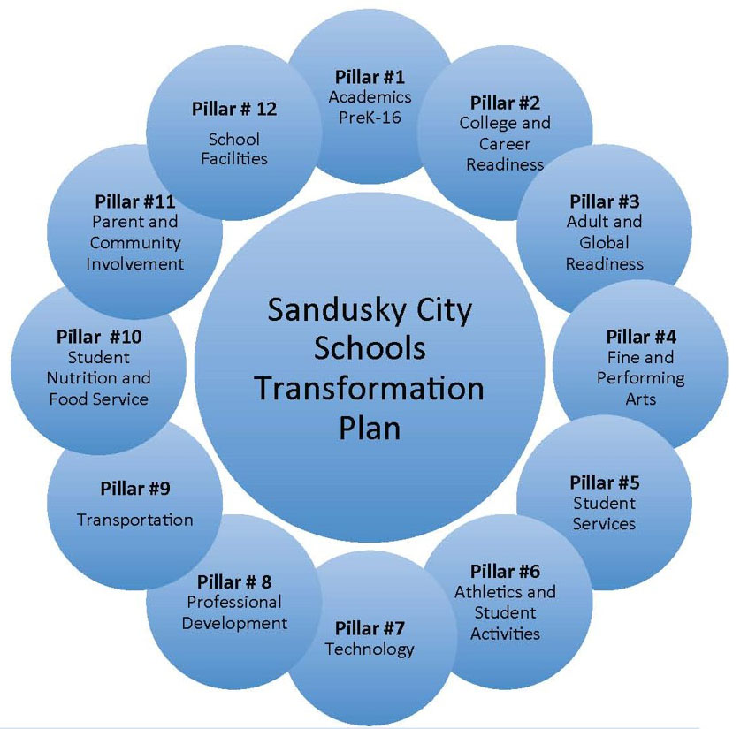

Slide 6
Mr. Robert Blatchford
Lesko Architecture

Slide 7
Project Update
Examine existing conditions
Surveys of each site
Traffic studies at each site
Dialogue with City Representatives

Slide 8
New Buildings Planning Update
Engagement of Administration, Teachers, & Staff
Educational Visioning/21st Century Learning Environments
Site visits to Vermilion PK-3 & Bellevue PK-5 Elementary Schools
Programming of Spaces
Conceptual Planning/Schematic Design

Slide 9
SMS/SHS Renovations Planning Update
Programming & Planning of all Renovation Projects
Summer 2017
Auditorium Stage Relief Vents & Roofing
Summer 2018
Science Labs
Rooms 300 & 301
Natatorium
Planetarium

Slide 10
Mr. Fred Rodgers Gilbane-Ozanne Construction Manager at Risk

Slide 11
CMR Process in Preconstruction & Construction
Upcoming 2017 Construction Activities
Auditorium Work
Abatement/Demo Activities
2018 Construction Activities
Two New Schools
LFI Renovation Work

Slide 12
Mrs. Gina Deppert
CFO & Treasurer

Slide 13
Composition of Construction Funding

Slide 14
Bank-qualified Interest Rates Versus Non-BQ Rates

Slide 15
Bank-qualified Interest Rates Versus Non-BQ Rates
Result: By capturing bank-qualified status on $9,900,000 with the 2016 Bond Anticipation Notes, overall interest cost during the life of the bonds will be approximately $550,000 less at a present value of just over $440,000.
Principal Payments
NBQ
BQ

Slide 16
Dr. Julie McDonald
Chief Academic Officer

Slide 17
Building Assignments & Academic Priorities
Buildings are being designed to be developmentally appropriate for the age range on the identified sites
Grade level alignment (both across grade level and above and below) will be better able to marshal resources for curriculum, instruction, and support services
Collegial professional development opportunities

Slide 18
Questions?

